Slide 1

Project Presentation
on
“OWASP AI Model Watermarking”
Presented by
Shaikh Arfat Zakir [231846]
Daire Sami Navid [231813]
Ansari Mohamed Abdullah [231803]
Bandiwadekar Yash [231810]
Under the guidance of
Dr. Shafi Pathan
(Principal)
Department of Computer Science & Engineering (IoTCSBCT), MHSSCE, Mumbai

Slide 2

Outline
  Team Responsibilities
  Objectives
  Problem Statement
  Literature Review
  Proposed Framework & Methodology
  What We Built: Sigil
  How It Works
  System Architecture
  The Dashboard
  Testing Any Model
  Results
  Project Timeline
  Expected vs Achieved
  Limitations & Next Steps
  Deployment & Deliverables
  References
Department of Computer Science & Engineering (IoTCSBCT), MHSSCE, Mumbai

Slide 3
Team Responsibilities
  Sami Daire (231813) – Project Lead, Cryptography & Verification Developer
  Mohamed Ansari (231803) – AI & Watermarking Developer
  Arfat Shaikh (231846) – Frontend & Integration Developer
  Yash Bandiwadekar (231810) – Backend Developer
Department of Computer Science & Engineering (IoTCSBCT), MHSSCE, Mumbai

Slide 4
Objectives
  To develop a secure AI model watermarking system that embeds cryptographic watermarks into AI/ML models for verifiable ownership and intellectual property protection.
  To implement a privacy-preserving ownership verification mechanism using Zero-Knowledge Proof (ZKP), enabling authentication without revealing the embedded watermark.
  To evaluate the robustness of the embedded watermark against model modification attacks such as fine-tuning, pruning, quantization, compression, and model extraction while maintaining model performance.
Department of Computer Science & Engineering (IoTCSBCT), MHSSCE, Mumbai

Slide 5
Problem Statement
To develop a secure and robust AI model watermarking system that enables verifiable ownership authentication while protecting AI models against theft, tampering, and unauthorized use.
Department of Computer Science & Engineering (IoTCSBCT), MHSSCE, Mumbai

Slide 6
Literature Review
Year | Paper Title | Methodology | Findings | Limitations
 | Methodology | Limitation | What we can improve
TdN (2023) | Trapdoor/normalization-based watermarking | Mainly focuses on ownership & ambiguity attacks | Test against more attacks like extraction, inversion, compression
IPRemover (2024) | Uses model inversion to remove/bypass watermarks | Shows existing watermarking can be attacked | Build watermark resistant to model-inversion/extraction attacks
SecureNet (2024) | Backdoor + license-key based model protection | Depends heavily on backdoor behavior | Combine watermark + cryptographic license verification
PK-Judge (2025) | Asymmetric cryptography + digital signatures + watermark | Watermark capacity/BER limitations | Optimize watermark size + robustness + model accuracy
IP Protection Systematization (2023/24) | Reviews watermarking, fingerprinting, access control & attacks | No complete implementation | Build an end-to-end protection framework
Department of Computer Science & Engineering (IoTCSBCT), MHSSCE, Mumbai

Slide 7
Proposed Framework
Programming Languages: Python, JavaScript, HTML5, CSS3
AI / Machine Learning: TensorFlow / PyTorch, NumPy, Scikit-learn
Cryptography & Security: SHA-256, RSA / ECC, Circom, SnarkJS (zk-SNARK)
Web Development: React.js, Tailwind CSS, FastAPI / Flask
Database & Storage: PostgreSQL / MongoDB
Development Tools: Visual Studio Code, Jupyter Notebook, Git & GitHub
Model Formats: .h5, .pt, .onnx
Department of Computer Science & Engineering (IoTCSBCT), MHSSCE, Mumbai

Slide 8
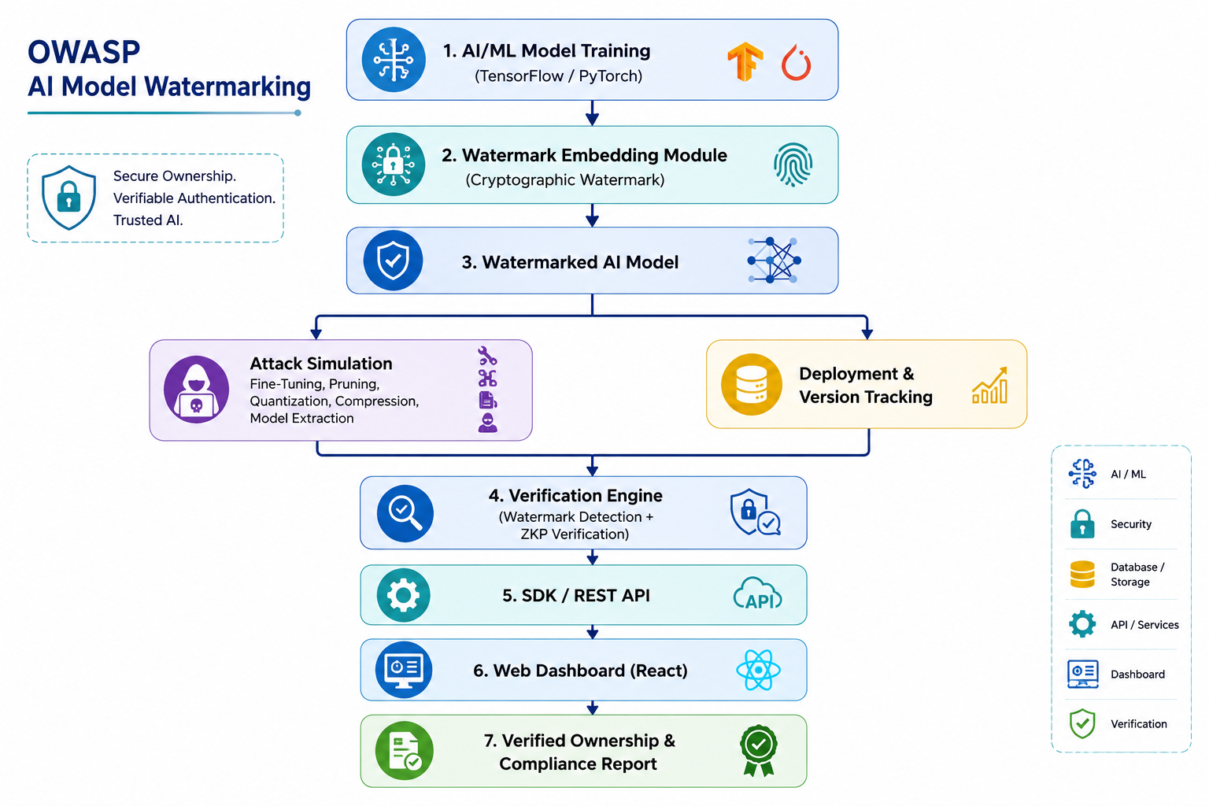
Department of Computer Science & Engineering (IoTCSBCT), MHSSCE, Mumbai

Slide 9
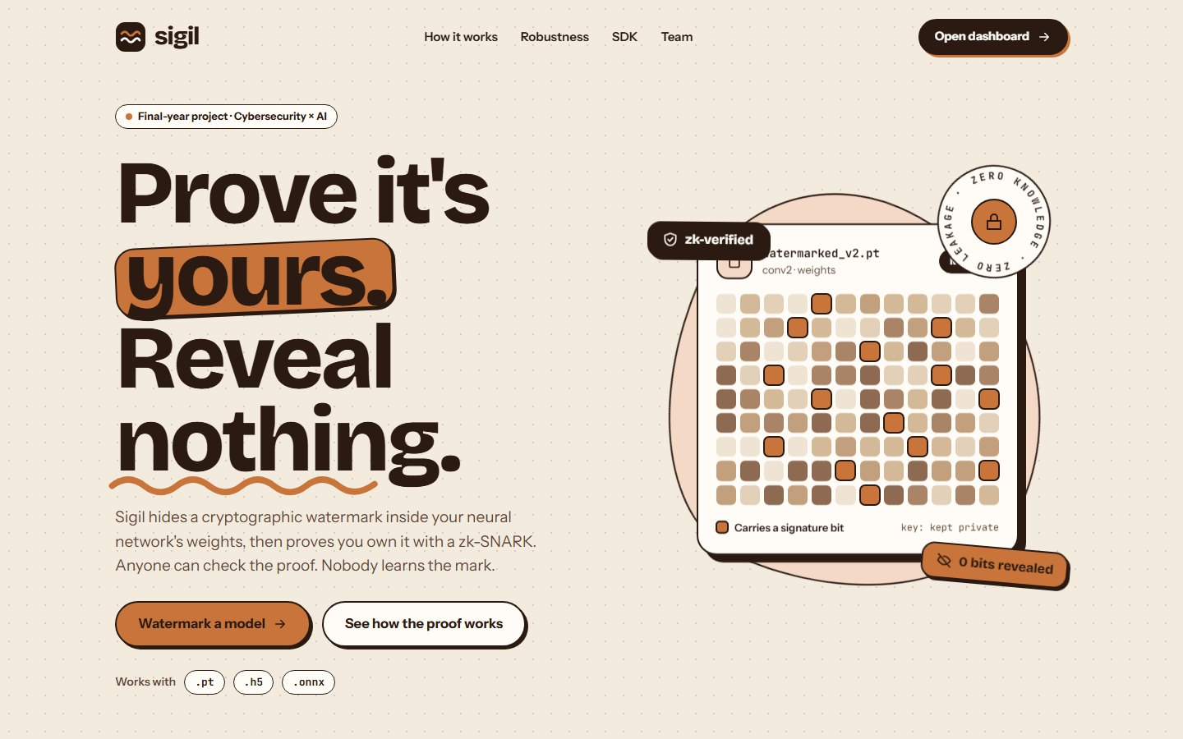
What We Built: Sigil
Prove a model is yours. Reveal nothing.
A 64-bit watermark hidden in one layer of the network, at an accuracy cost of 0.03 percentage points
A Groth16 zero-knowledge proof of ownership: the verifier learns 0 of the 64 watermark bits
Every proof is bound to the owner's Ed25519 key, the exact model file and the claim
A web dashboard plus a Python SDK and command line; runs fully offline on a laptop
The project's home page
Department of Computer Science & Engineering (IoTCSBCT), MHSSCE, Mumbai
Notes:
Sigil is the system we built. The watermark lives in the weights; ownership is proven with a zero-knowledge proof, so nobody learns the watermark. Everything shown today runs on this laptop.

Slide 10
How It Works
1
2
3
4
Embed
Commit
Prove
Verify
A secret seed generates a key and a 64-bit signature; training hides the signature in layer conv2.
Before release, the owner publishes a Poseidon hash of the seed, signed with an Ed25519 key, and gets a registry timestamp.
For a suspect model, a Circom circuit re-derives the key, reads the 64 bits and enforces at most 8 wrong; SnarkJS outputs a Groth16 proof.
Anyone checks the 879-byte proof in milliseconds, off-chain or on an Ethereum-style chain. 0 bits revealed.
The verifier accepts only if all 11 checks pass
owner's signature · trusted registry receipt · registered before the claim · claim matches the registration and the file · owner's key · watermark settings · published commitment · this exact model (w_hash) · this claim (nonce) · Groth16 proof
Department of Computer Science & Engineering (IoTCSBCT), MHSSCE, Mumbai
Notes:
Four moves: embed, commit, prove, verify. The important part is the last box: a valid zk-SNARK alone is not enough, the verifier ties the proof to the owner, the exact model file and a fresh claim.

Slide 11
System Architecture
Browser
Demo server
Engine
Zero knowledge
React + TypeScript dashboard (frontend/), no internet needed
Python, 127.0.0.1:8765; JSON API, one job at a time
Demo scripts + sigil SDK: PyTorch, Ed25519, Poseidon; .pt, .h5, .onnx
Circom circuit (116,822 constraints), SnarkJS Groth16 prove and verify
Everything runs locally: nothing is sent to a cloud service. Replay mode needs only Python.
Results store
Models under test
On-chain verifier
demo/results/*.json and the model checkpoints the pages read
the owner's models, stolen copies made live, your own files
Solidity contract (local Hardhat chain): 243,225 gas
Department of Computer Science & Engineering (IoTCSBCT), MHSSCE, Mumbai
Notes:
The browser talks to a small local Python server. The server runs the demo scripts, which use our sigil SDK, PyTorch and the Circom/SnarkJS toolchain. The same proof also verifies on a Solidity contract.

Slide 12
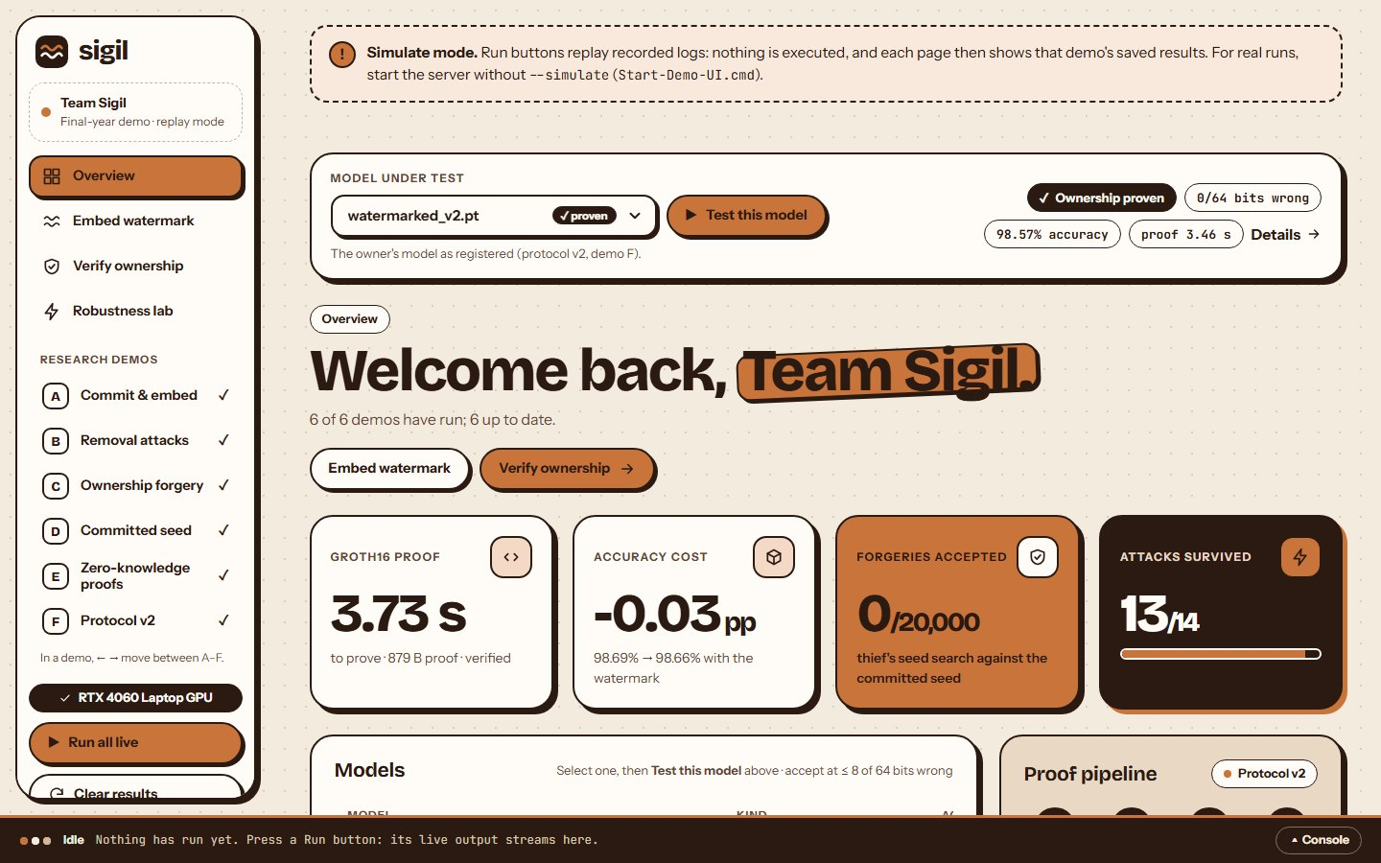
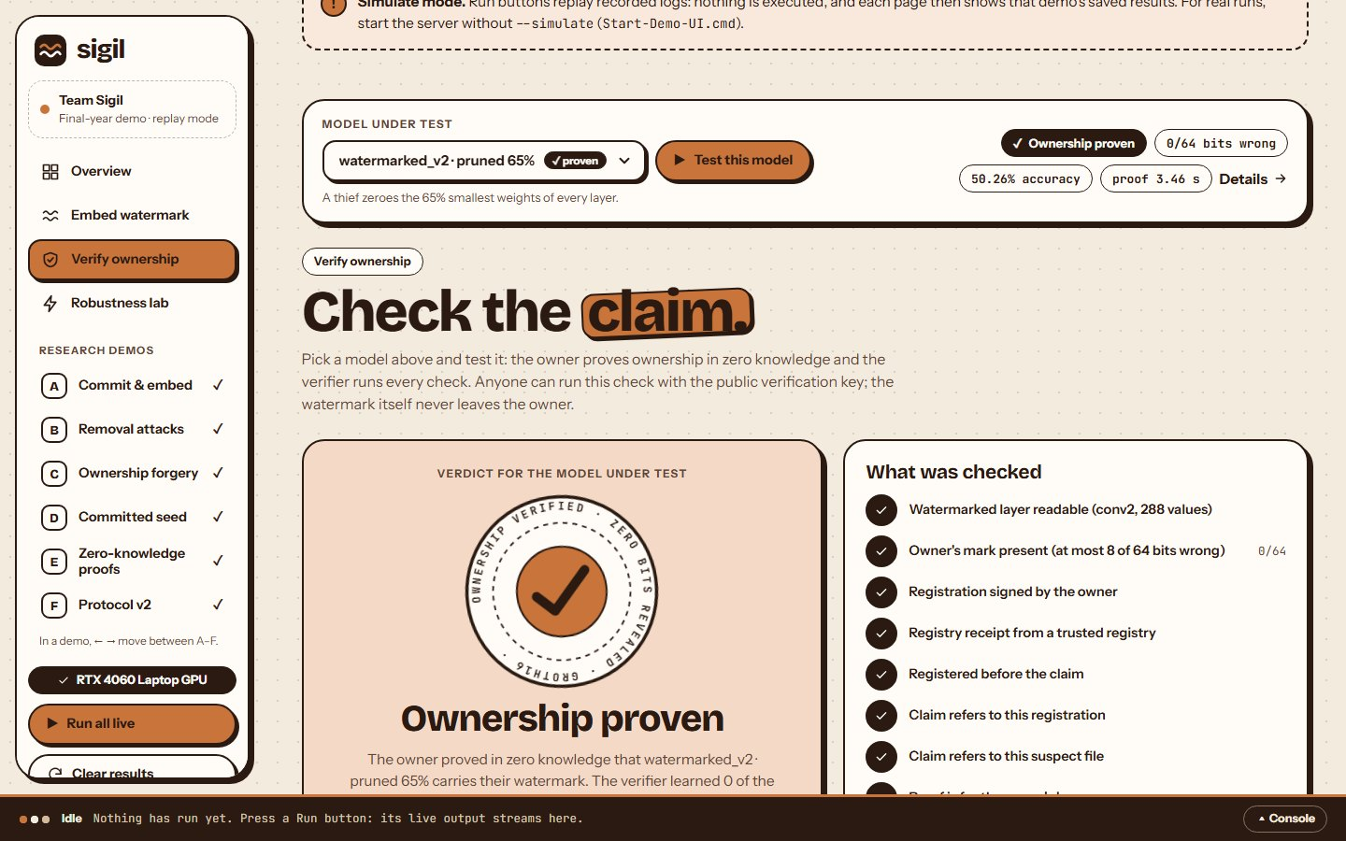
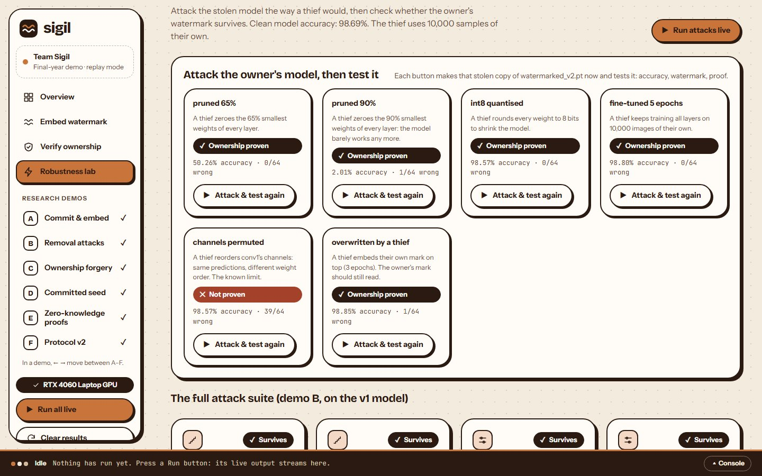
The Dashboard
Overview
Headline numbers, every model with its test result, audit log
Verify ownership
Pick a model and test it: the verdict and all 11 checks
Robustness lab
Attack the owner's model live, then test the stolen copy
Pages start empty and fill in as each demo runs; Clear resets them for the next audience. Every page has a Model under test menu.
Department of Computer Science & Engineering (IoTCSBCT), MHSSCE, Mumbai
Notes:
Live in the app: Overview, Verify and the Robustness lab. Pages start empty, so everything the audience sees comes from runs they watch.

Slide 13
Testing Any Model
Model | Accuracy | Bits wrong | Verdict
Owner's model (v2) | 98.57% | 0 / 64 | Proven
Pruned 65% | 50.26% | 0 / 64 | Proven
Pruned 90% | 2.01% | 1 / 64 | Proven
int8 quantised | 98.57% | 0 / 64 | Proven
Fine-tuned 5 epochs | 98.80% | 0 / 64 | Proven
Overwritten by a thief | 98.85% | 1 / 64 | Proven
Channels permuted | 98.57% | 39 / 64 | Not proven
v1 owner's model | 98.66% | 31 / 64 | Not proven
Clean model | 98.69% | 26 / 64 | Not proven
Null models (×4) | ≈ 98.8% | 28–31 / 64 | Not proven
Pick any model, press Test
The Model under test menu: the owner's models, six stolen copies made live, never-watermarked models, or your own file.
A ruined copy still proves ownership
Pruned 90%: accuracy 2%, yet 63 of 64 bits read correctly and a fresh proof verifies.
The known limit
Permuting channels hides the mark unless the owner realigns the model first.
Department of Computer Science & Engineering (IoTCSBCT), MHSSCE, Mumbai
Notes:
Each test builds the model (attacked copies are made live), measures accuracy, reads the watermark and, if it's there, makes and verifies a new Groth16 proof for that exact file. Accept at most 8 of 64 bits wrong.

Slide 14
Results
−0.03 pp
3.73 s
0 of 64
accuracy cost of the watermark (98.69% → 98.66%)
to make a Groth16 proof; the proof is 879 bytes
watermark bits revealed to the verifier
0 / 20,000
13 / 14
4 / 4
thief seed-search forgeries accepted
removal attacks survived (permutation is the known gap)
misuse attempts rejected: replay, wrong model, tampered proof, untrusted registry
Also: verified on a local Ethereum chain (243,225 gas) · 116,822-constraint circuit · 108 server and 151 SDK automated tests pass
Department of Computer Science & Engineering (IoTCSBCT), MHSSCE, Mumbai
Notes:
All numbers come from the saved results of real runs (MNIST CNN, 64-bit signature, accept at 8 of 64 wrong).

Slide 15
Project Timeline
[ Week Activity
  1–2 Problem definition + literature
  3–4 System design & tool finalization
  5–7 Data acquisition
  8–9 Blockchain/Frontend & Backend integration
  10–11 Testing + bug fixing
  12 Report preparation & review ]
Department of Computer Science & Engineering (IoTCSBCT), MHSSCE, Mumbai

Slide 16
Expected Outcomes
  A secure AI model watermarking system for ownership protection.
  Reliable watermark detection and verification using cryptographic techniques.
  Privacy-preserving ownership authentication through Zero-Knowledge Proof (ZKP).
  Robust watermark resistance against fine-tuning, pruning, quantization, compression, and model extraction attacks.
  A framework-agnostic SDK/API for watermark embedding, detection, and verification.
  A web-based dashboard for AI model management, verification, and compliance reporting.
Department of Computer Science & Engineering (IoTCSBCT), MHSSCE, Mumbai

Slide 17
Expected vs Achieved
Expected outcome | Status | Evidence
Framework-agnostic Python SDK/API (.pt, .h5, .onnx) | Achieved | sigil SDK and command line; safe loaders for all three formats
Privacy-preserving ZKP verification | Achieved | Circom + Groth16: 0 of 64 bits revealed; verified off-chain and on-chain
Interactive web dashboard | Achieved | Overview, Embed, Verify, Robustness, research demos A–F, testing any model
Robust to fine-tuning, pruning, quantization | Achieved | 13 of 14 attacks survived; attacked copies still prove ownership
Resistance to model extraction | Sem 8 | Not covered by a white-box mark; a trigger-set mark is planned
FastAPI + PostgreSQL backend for tracking and audit | Sem 8 | Today: a local server with JSON results and an audit log
Department of Computer Science & Engineering (IoTCSBCT), MHSSCE, Mumbai
Notes:
Four of the six expected outcomes are done and demonstrable today; the backend database and extraction resistance are Semester 8 work.

Slide 18
Limitations & Next Steps
Honest limits
White-box only: the verifier needs the suspect model's weights
Permuting channels hides the mark unless the owner realigns first
64 bits is a demo size: a forger needs about 4 billion tries
The 8-of-64 threshold is indicative, not a calibrated false-positive rate
Trusted setup: a single phase-2 contributor
Next steps (Semester 8)
FastAPI + PostgreSQL backend: watermark tracking and verification history
A trigger-set (black-box) mark against model extraction
256-bit signatures: forging would take about 10³⁶ tries
Automatic channel realignment before proving
Larger models and a multi-party trusted setup
Department of Computer Science & Engineering (IoTCSBCT), MHSSCE, Mumbai
Notes:
We state the limits up front: they are also shown in the app's presenter notes. Semester 8 closes the biggest ones.

Slide 19
Deployment & Deliverables
1
Unzip owasp-wm-demo.zip (about 208 MB: code, models, results, proving keys)
Deliverables
Working demo app, Python SDK and Circom circuit
Sigil-User-Guide.pdf: 40-page illustrated guide
DEPLOY.md: step-by-step runbook an AI agent can follow
DEMO.md: presentation runbook
108 server and 151 SDK automated tests passing
2
Run .\setup.ps1 --demo: installs everything in 5–15 minutes
3
Run scripts\verify_deploy.py: must print ALL CHECKS PASSED (it makes a real proof)
4
Double-click Start-Demo-UI.cmd and open http://127.0.0.1:8765
Replay mode needs only Python: Start-Demo-UI-Simulate.cmd
Department of Computer Science & Engineering (IoTCSBCT), MHSSCE, Mumbai
Notes:
One zip, one setup command, one check command. A teammate's AI assistant can deploy it by following DEPLOY.md.

Slide 20
References
[1] Y. Uchida, Y. Nagai, S. Sakazawa, and S. Satoh, “Embedding Watermarks into Deep Neural Networks,” Proceedings of the ACM International Conference on Multimedia Retrieval (ICMR), pp. 269–277, 2017.
[2] X. Zhang, H. Wu, and X. Zhang, “Protecting Intellectual Property of Deep Neural Networks with Watermarking: A Survey,” IEEE Access, vol. 9, pp. 118862–118882, 2021.
Department of Computer Science & Engineering (IoTCSBCT), MHSSCE, Mumbai

Slide 21
References (continued)
[3] J. Groth, “On the Size of Pairing-Based Non-interactive Arguments,” Advances in Cryptology – EUROCRYPT 2016, LNCS 9666, pp. 305–326, 2016.
[4] N. Lukas, E. Jiang, X. Li, and F. Kerschbaum, “SoK: How Robust is Image Classification Deep Neural Network Watermarking?,” IEEE Symposium on Security and Privacy (S&P), pp. 787–804, 2022.
[5] L. Grassi, D. Khovratovich, C. Rechberger, A. Roy, and M. Schofnegger, “Poseidon: A New Hash Function for Zero-Knowledge Proof Systems,” USENIX Security Symposium, 2021.
[6] N. Sheybani, Z. Ghodsi, R. Kapila, and F. Koushanfar, “ZKROWNN: Zero Knowledge Right of Ownership for Neural Networks,” ACM/IEEE Design Automation Conference (DAC), 2023.
[7] iden3, “Circom 2 and SnarkJS documentation,” https://docs.circom.io.
Department of Computer Science & Engineering (IoTCSBCT), MHSSCE, Mumbai

Slide 22
Thank You

